Slide 1

Max Car Sales
Used and Salvage Car Sales
Fix It Yourself and Save $$$

Slide 2
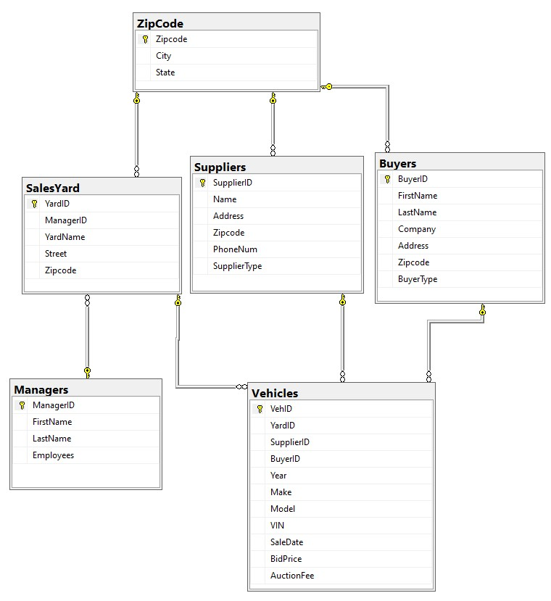
Database Diagram

Slide 3
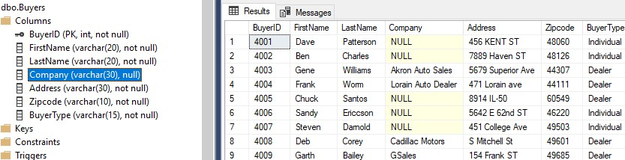
Buyers Table

Slide 4
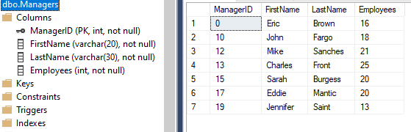
Managers Table

Slide 5
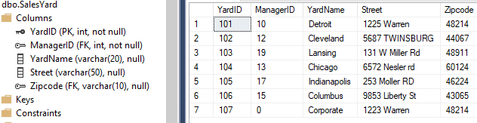
Sales Yard Table

Slide 6
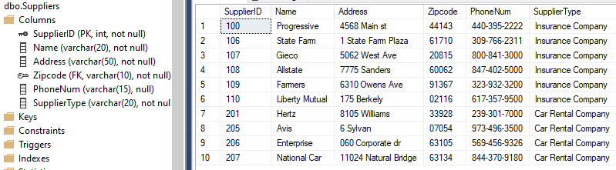
Suppliers Table

Slide 7
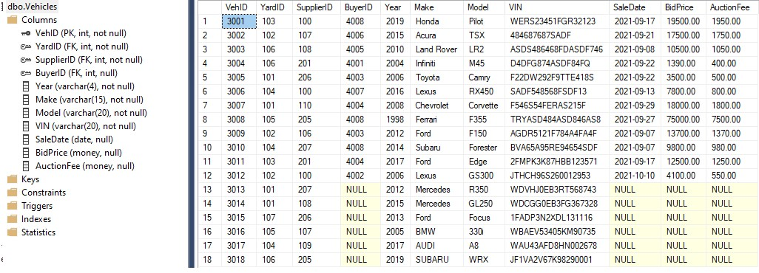
Vehicles Table

Slide 8
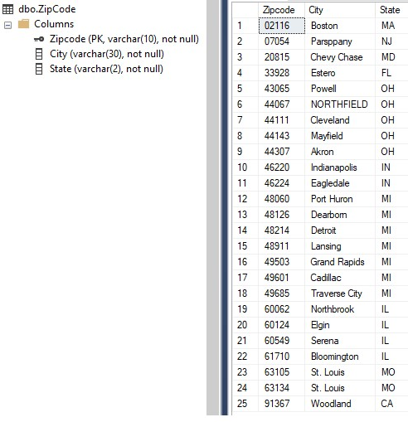
Zip Code
Table

Slide 9
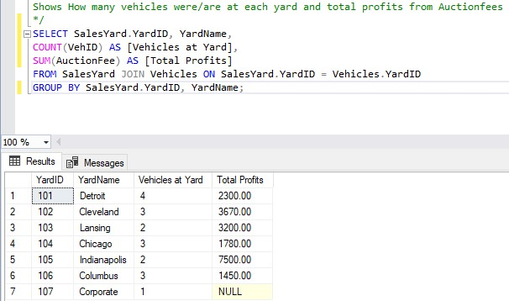
Summary Query

Slide 10
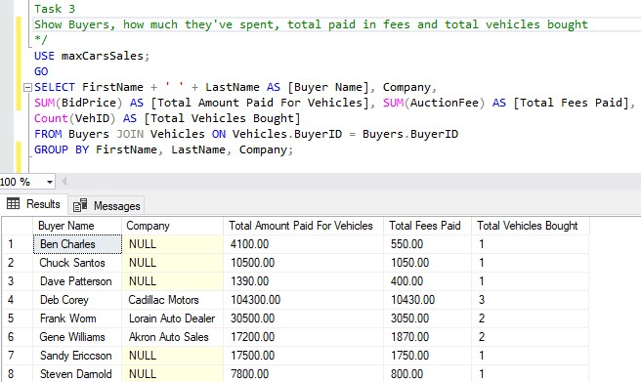
Summary Query

Slide 11
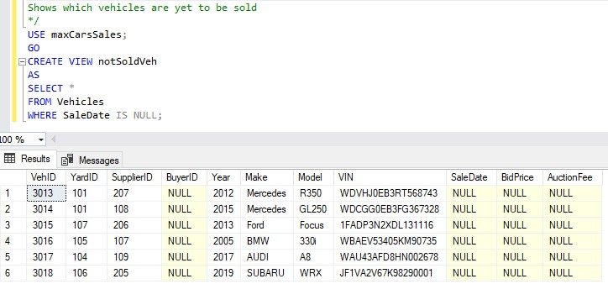
Views

Slide 12
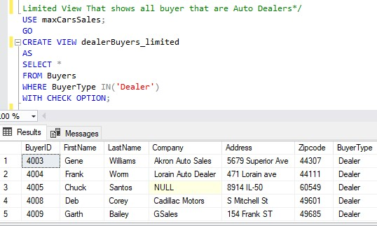
Views

Slide 13
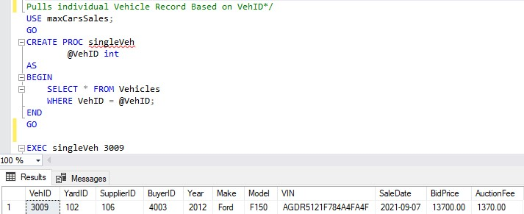
Stored Procedures

Slide 14
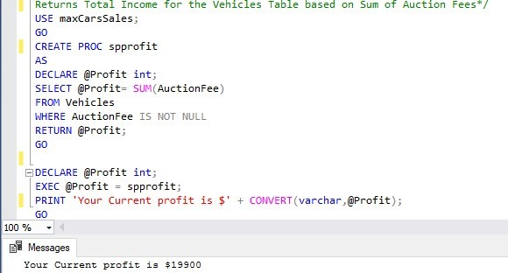
Stored Procedures

Slide 15
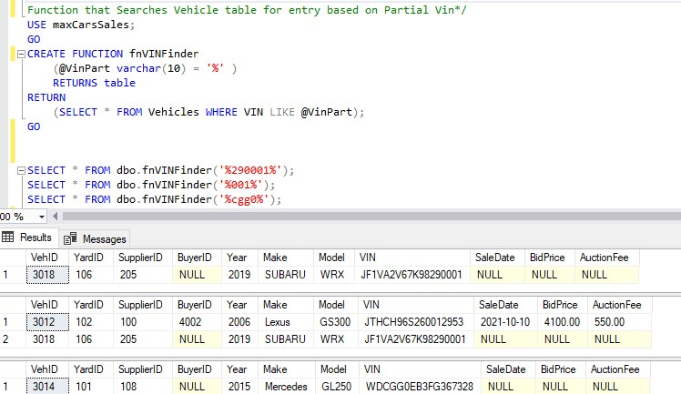
Functions
Purpose of this Function:
Finds a vehicle record based on a partial VIN.
This is very useful because the vin is a universally used serial number and is a common way to identify specific vehicles. With this function, if you have the VIN, you can find the vehicle record.

Slide 16
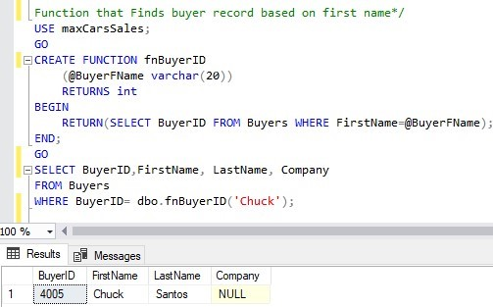
Functions
Purpose of this Function:
It finds the BuyerID, First Name, Last Name and other information based on the buyers first name.
It can be used as a format to create other functions to find records based on limited data.

Slide 17
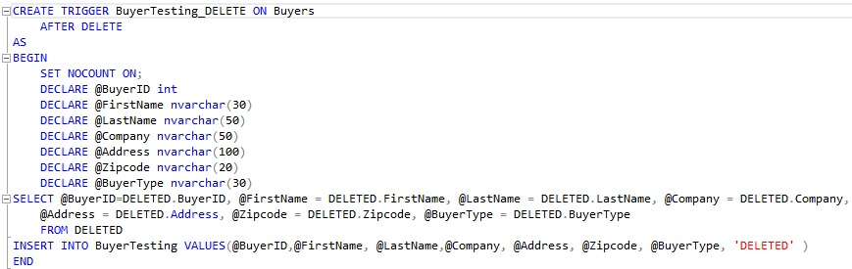
Triggers
Function of this Trigger: This trigger creates a copy of a deleted record in a transaction table to preserve data and show what was done to the record.

Slide 18
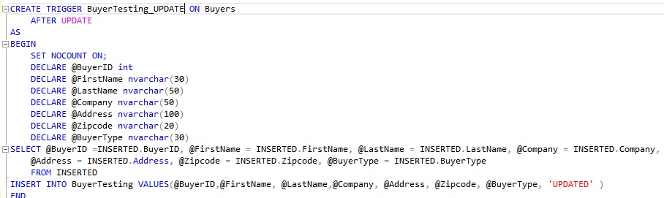
Triggers
Function of this Trigger: Adds record to a transaction table that shows what record was updated.

Slide 19
Reflections
What went well:
I really enjoyed creating the database structure and imagining how it work if it was implemented in an actual company that dealt with selling vehicles.
Creating Summary queries was engaging because it forced me to imagine scenarios that would occur in a company and how to create the queries for the them. Functions and Procedures were done in a similar way, but they are a bit more complicated, so much more effective and satisfying in the end.
Problems:
Data entry was very time consuming. I found many mistakes as I worked my way through the data in future assignments. I was forced to go back and make changes that took time because of the relationships between tables that needed to be maintained.

Slide 20
Reflections
What I learned:
I learned that a database is almost never done, In the sense that you can always adjust your tables by adding columns or even adding other tables.
Overall, it was an enjoyable experience but the more I worked on the database the more I realized I had to learn.
Adjustments for the future:
In the Future, I would like to add more columns for the buyer table, a contact info column that I didn’t add.
As the company grows and other types of buyers and suppliers are added, I would like to add a BuyerType and SupplierType table so that the columns in the Buyer and Supplier tables can have numerical values instead of strings, these can cause errors if entered incorrectly and the SQL would have no way to discern the difference.

